Slide 1
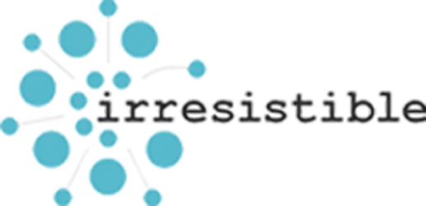
Lesson 6 Antibacteriele Effecten van Nanoproducten

Slide 2
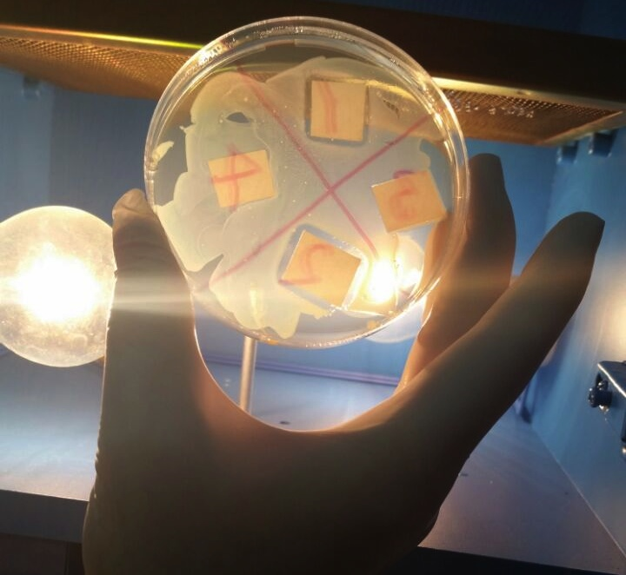
Het Resultaat van het Experiment van les 5 (Photo)

Slide 3
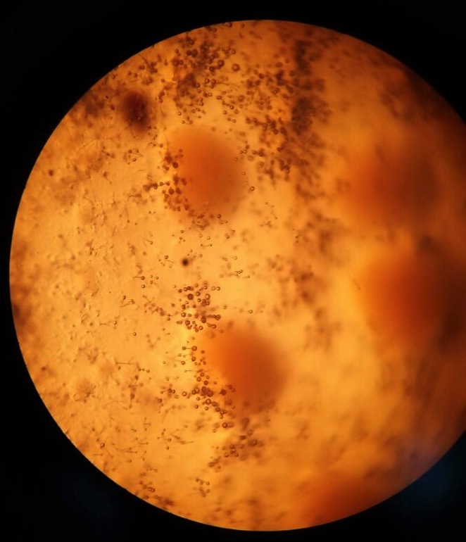
Het Resultaat van het Experiment van les 5 (Licht microscoop)

Slide 4
Het Resultaat van het Experiment van les 5 (SEM opname)

Slide 5
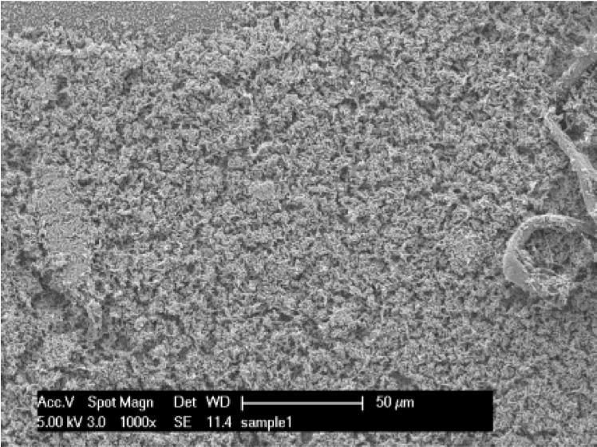
Gezonde E. Coli Bacterie Cellen 1000x (50µm)
(Muskin et al., 2008)

Slide 6
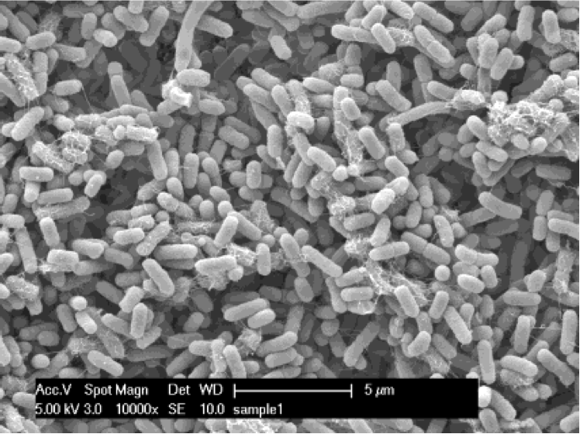
Gezonde E. Coli Bacterie Cellen 10000x (5µm)
(Muskin et al., 2008)

Slide 7
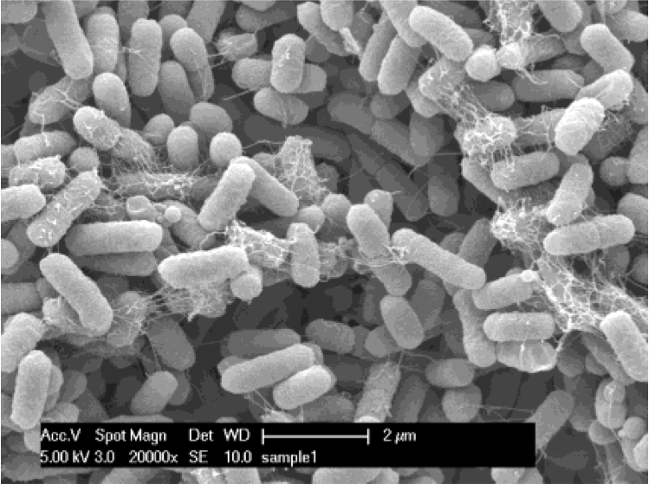
Gezonde E. Coli Bacterie Cellen 20000x (2µm)
(Muskin et al., 2008)

Slide 8
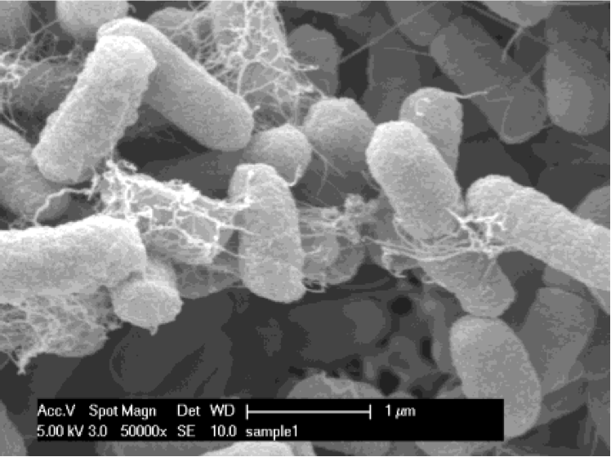
Gezonde E. Coli Bacterie Cellen 50000x (1µm)
(Muskin et al., 2008)

Slide 9
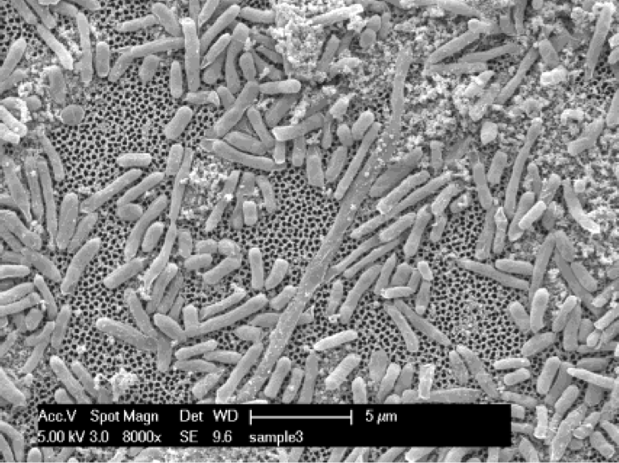
Ongezonde E. Coli Bacterie Cellen 8000x (5µm)
(Muskin et al., 2008)

Slide 10
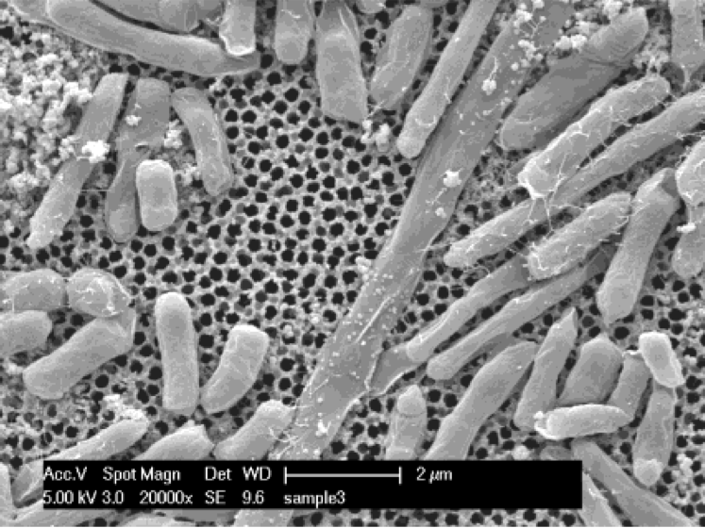
Ongezonde E. Coli Bacterie Cellen 20000x (2µm)
(Muskin et al., 2008)

Slide 11
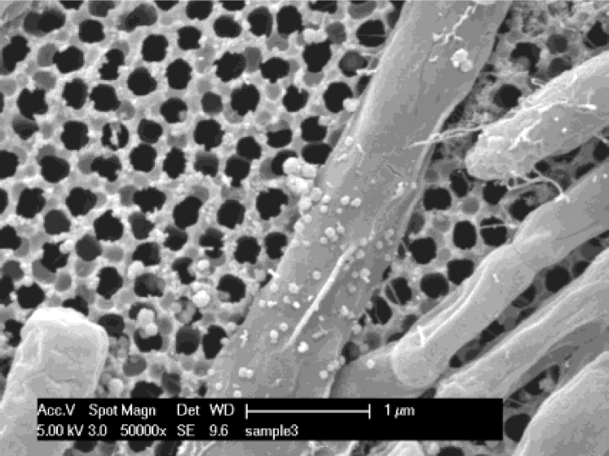
Ongezonde E. Coli Bacterie Cellen 50000x (1µm)
(Muskin et al., 2008)

Slide 12
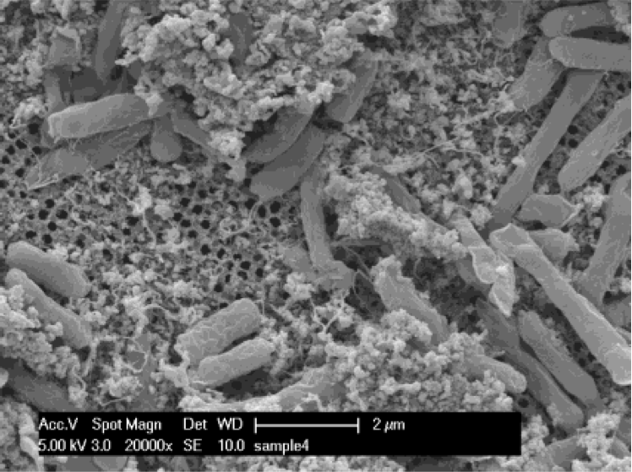
Ongezonde E. Coli Bacterie Cellen 20000x (2µm)
(Muskin et al., 2008)

Slide 13
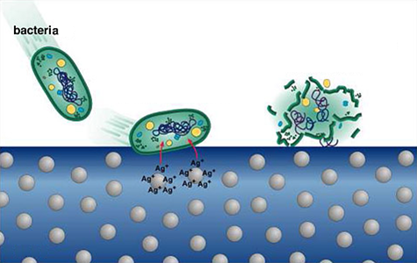
Mechanisme antibacteriele effect
CF: http://www.isern.tv/news/
http://www.nanomark.org.tw/Eng/License/12/

Slide 14
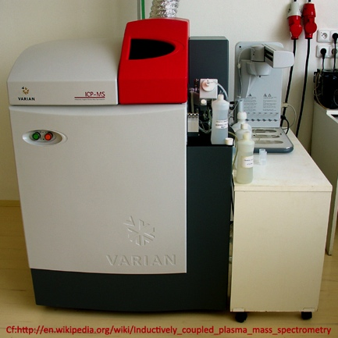
Een ICPMS-apparaat

Slide 15
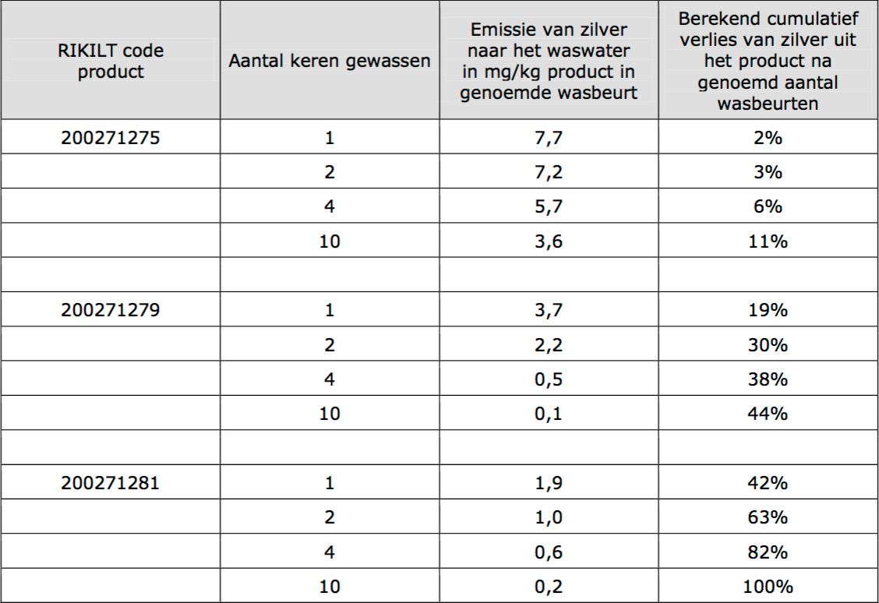
ICPMS Analyse RIKILT
(This analysis was carried out at the Central Laboratory of the Yildiz Technical University Science and Technology Research and Application Center, January 2015.)

Slide 16
References
Muskin, J., Wattnem, J., Ragusa, M. and Hug, B. (2008). Real Science or Marketing Hype: Student-Designed Experiments Test the Antimicrobial Effects of Silver Nanoparticles. The Science Teacher, 75(4), 57-61.
http://www.isern.tv/news/
http://www.nanomark.org.tw/Eng/License/12/
https://en.wikipedia.org/wiki/Inductively_coupled_plasma_mass_spectrometry

